Slide 1
Overview
Basic Terminologies related to cryptography and cryptanalysis
Symmetric Encryption and Requirements
Cryptography and Cryptanalysis
Mode of Cryptanalytic Attacks
Brute Force Attack

Slide 2
Some Basic Terminology
Plaintext - original message
Ciphertext – encrypted or coded message
Cipher - algorithm for transforming plaintext to ciphertext
Key - info used in cipher known only to sender/receiver
Encipher (encrypt) - converting plaintext to ciphertext
Decipher (decrypt) - recovering plaintext from ciphertext
Cryptography - study of encryption principles/methods
Cryptanalysis (codebreaking) - study of principles/ methods of deciphering ciphertext without knowing key
Cryptology - field of both cryptography and cryptanalysis

Slide 3
Example Encryption
Plaintext 10101
Secret Key 11111
Ciphertext (XOR of plaintext and secret key, i.e.,
01010)
Note: Plaintext size is five bits long, therefore, secret key is also five bits long, hence total 2^5=32 secret keys are possible

Slide 4
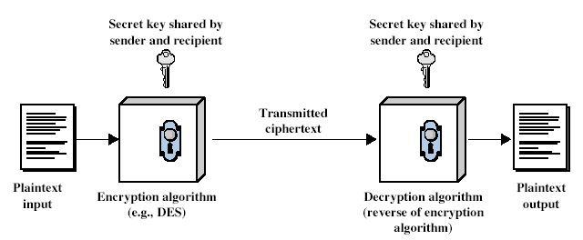
Symmetric Encryption
All traditional schemes are symmetric / single key / private-key encryption algorithms, with a single key, used for both encryption and decryption.
Since both sender and receiver are equivalent, either can encrypt or decrypt messages using that common key.
Notes:
Symmetric encryption, also referred to as conventional encryption or single-key encryption, was the only type of encryption in use prior to the development of public-key encryption in the 1970s. It remains by far the most widely used of the two types of encryption.
Detail the five ingredients of the symmetric cipher model, shown in Stallings Figure 2.1:
plaintext - original message
encryption algorithm – performs substitutions/transformations on plaintext
secret key – control exact substitutions/transformations used in encryption algorithm
ciphertext - scrambled message
decryption algorithm – inverse of encryption algorithm

Slide 5
Requirements
Two requirements for secure use of symmetric encryption:
a strong encryption algorithm
a secret key known only to sender / receiver
mathematically have:
Y = E_{K}(X)
X = D_{K}(Y)
If P is the plaintext, C is the ciphertext, and K is the key,
Notes:
We assume that it is impractical to decrypt a message on the basis of the cipher- text plus knowledge of the encryption/decryption algorithm, and do not need to keep the algorithm secret; rather we only need to keep the key secret. This feature of symmetric encryption is what makes it feasible for widespread use. It allows easy distribution of s/w and h/w implementations.

Slide 6
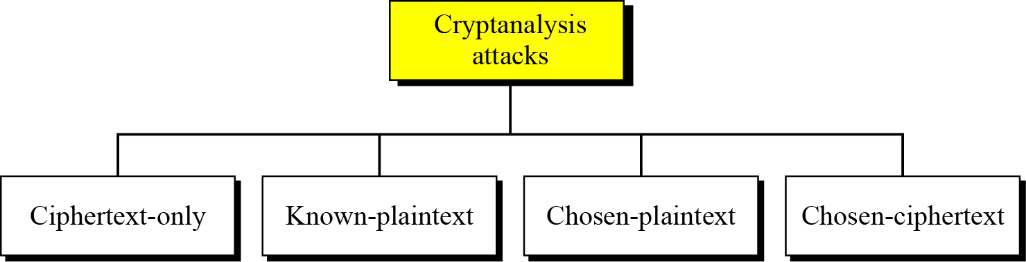
Cryptography (Secrete writing)
Characterize cryptographic system by:
type of encryption operations used
substitution / transposition
number of keys used
single-key or private / two-key or public
way in which plaintext is processed
block / stream
Cryptanalysis
As cryptography is the science and art of creating secret codes, cryptanalysis is the science and art of breaking those codes
Notes:
Cryptographic systems can be characterized along these three independent dimensions.
Typically objective is to recover the key in use rather then simply to recover the plaintext of a single ciphertext.
There are two general approaches:
Cryptanalytic attacks rely on the nature of the algorithm plus perhaps some knowledge of the general characteristics of the plaintext or even some sample plaintext-ciphertext pairs.
Brute-force attacks try every possible key on a piece of ciphertext until an intelligible translation into plaintext is obtained. On average,half of all possible keys must be tried to achieve success.

Slide 7
Asymmetric Encryption
Two different keys are used one for encryption and other key for decryption.
Public key and private key (Mathematically related to each other)
Provides more security as compared to symmetric key
Complex and time taking as compared to symmetric key
Notes:
Symmetric encryption, also referred to as conventional encryption or single-key encryption, was the only type of encryption in use prior to the development of public-key encryption in the 1970s. It remains by far the most widely used of the two types of encryption.
Detail the five ingredients of the symmetric cipher model, shown in Stallings Figure 2.1:
plaintext - original message
encryption algorithm – performs substitutions/transformations on plaintext
secret key – control exact substitutions/transformations used in encryption algorithm
ciphertext - scrambled message
decryption algorithm – inverse of encryption algorithm

Slide 8
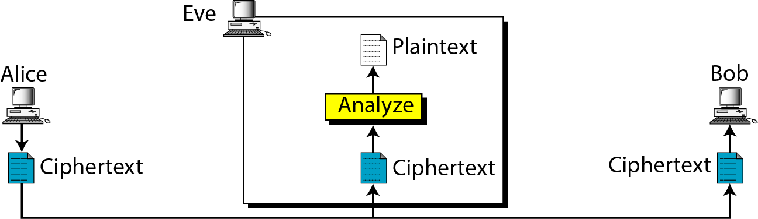
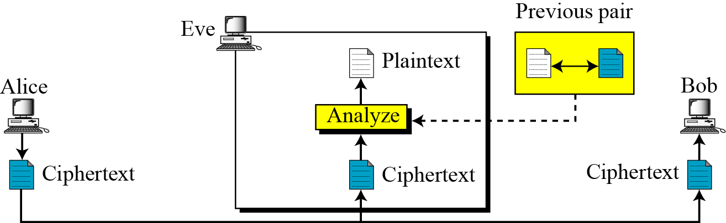
Ciphertext-Only Attack
Known : • Encryption algorithm
• Ciphertext
Known-Plaintext Attack
Known : • Encryption algorithm
• Ciphertext
• One or more plaintext–ciphertext pairs formed with the secret key
Notes:
The ciphertext-only attack is the easiest to defend against because the opponent has the least amount of information to work with.
All these are examples of known plaintext. With this knowledge, the analyst may be able to deduce the key on the basis of the way in which the known plaintext is
transformed.

Slide 9
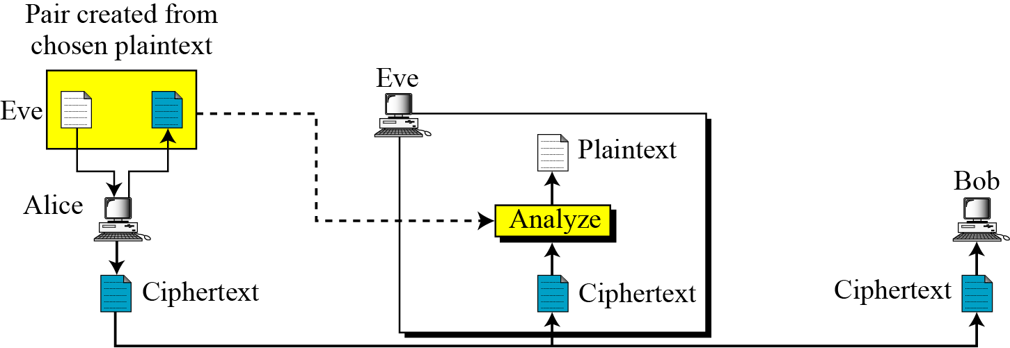
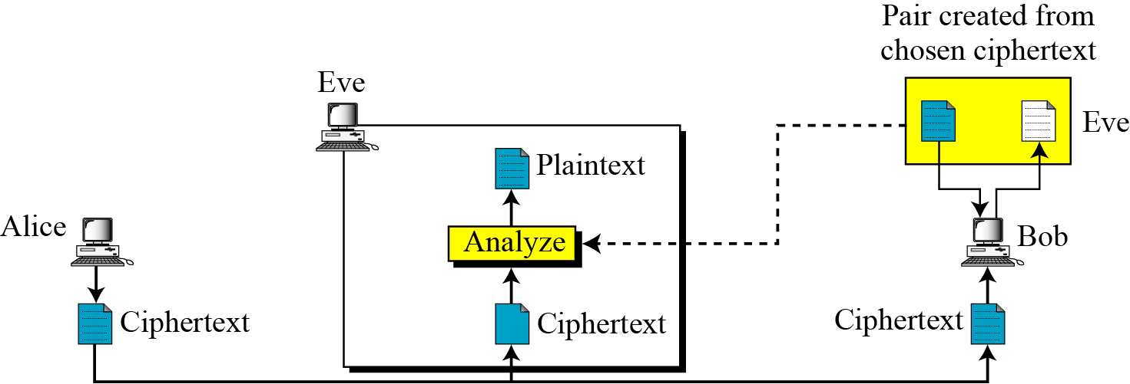
Chosen-Plaintext Attack
•Encryption algorithm
• Ciphertext
• Plaintext message chosen by cryptanalyst, together with its corresponding ciphertext
generated with the secret key
• Encryption algorithm
• Ciphertext
• Ciphertext chosen by cryptanalyst, together with its corresponding decrypted
plaintext generated with the secret key
_{Chosen-Ciphertext Attack}
Notes:
If the analyst is able somehow to get the source system to insert into the
system a message chosen by the analyst, then a chosen-plaintext attack is possible.
For example, if an entire accounting file is being transmitted, the opponent may know the placement of certain key words in the header of the file.
As another example, the source code for a program developed by Corporation X might include a copyright statement in some standardized position.

Slide 10
Unconditional vs Computation Security
Unconditional security
no matter how much computer power or time is available, the cipher cannot be broken since the ciphertext provides insufficient information to uniquely determine the corresponding plaintext
Computational security
given limited computing resources (e.g. time needed for calculations is greater than age of universe), the cipher cannot be broken
Notes:
Two more definitions are worthy of note. An encryption scheme is unconditionally secure if the ciphertext generated by the scheme does not contain enough information to determine uniquely the corresponding plaintext, no matter how much ciphertext is available. An encryption scheme is said to be computationally secure if either the cost of breaking the cipher exceeds the value of the encrypted information, or the time required to break the cipher exceeds the useful lifetime of the information. Unconditional security would be nice, but the only known such cipher is the one-time pad (later).
For all reasonable encryption algorithms, we have to assume computational security where it either takes too long, or is too expensive, to bother breaking the cipher.

Slide 11
Brute Force Search
Always possible to simply try every key
Most basic attack, proportional to key size
Key Size (bits) | Number of Alternative Keys | Time required at 1 decryption/µs | Time required at 10⁶ decryptions/µs
32 | 2³² = 4.3 × 10⁹ | 2³¹ µs = 35.8 minutes | 2.15 milliseconds
56 | 2⁵⁶ = 7.2 × 10¹⁶ | 2⁵⁵ µs = 1142 years | 10.01 hours
128 | 2¹²⁸ = 3.4 × 10³⁸ | 2¹²⁷ µs = 5.4 × 10²⁴ years | 5.4 × 10¹⁸ years
168 | 2¹⁶⁸ = 3.7 × 10⁵⁰ | 2¹⁶⁷ µs = 5.9 × 10³⁶ years | 5.9 × 10³⁰ years
26 characters (permutation) | 26! = 4 × 10²⁶ | 2 × 10²⁶ µs = 6.4 × 10¹² years | 6.4 × 10⁶ years
Notes:
A brute-force attack involves trying every possible key until an intelligible translation of the ciphertext into plaintext is obtained. On average, half of all possible keys must be tried to achieve success. Stallings Table shows how much time is required to conduct a brute-force attack, for various common key sizes (DES is 56, AES is 128, Triple-DES is 168, plus general mono-alphabetic cipher), where either a single system or a million parallel systems, are used.

